Slide 1
Hunstanton & Ingoldisthorpe Primary Schools
Mobilisation

Slide 2
Theme days, Christmas menus, quality of the food improved & Maintained
Swift Kitchen Changes to meal ordering
People are our greatest strength !!
Innovatiation, Forward thinking and next steps

Slide 5
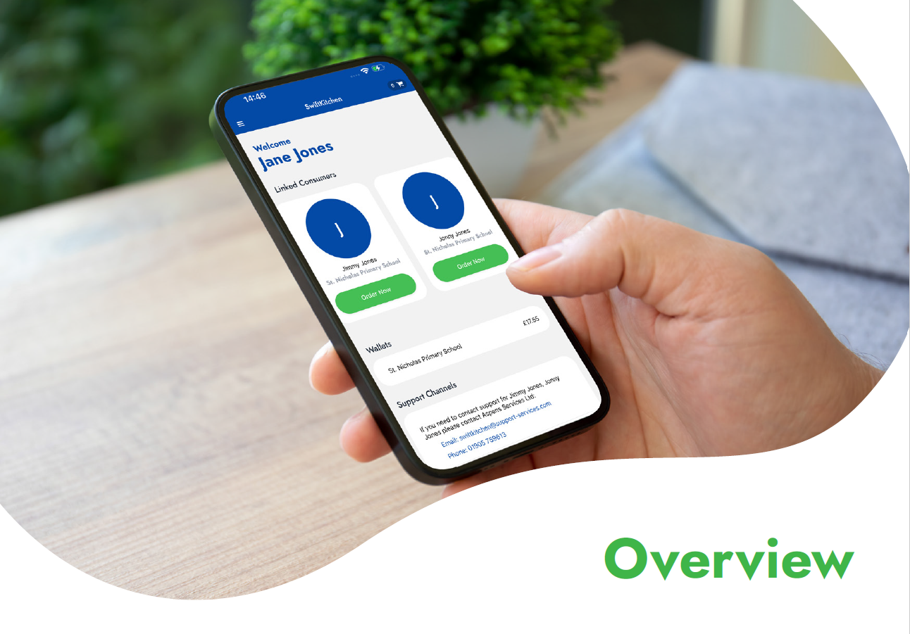

Slide 6
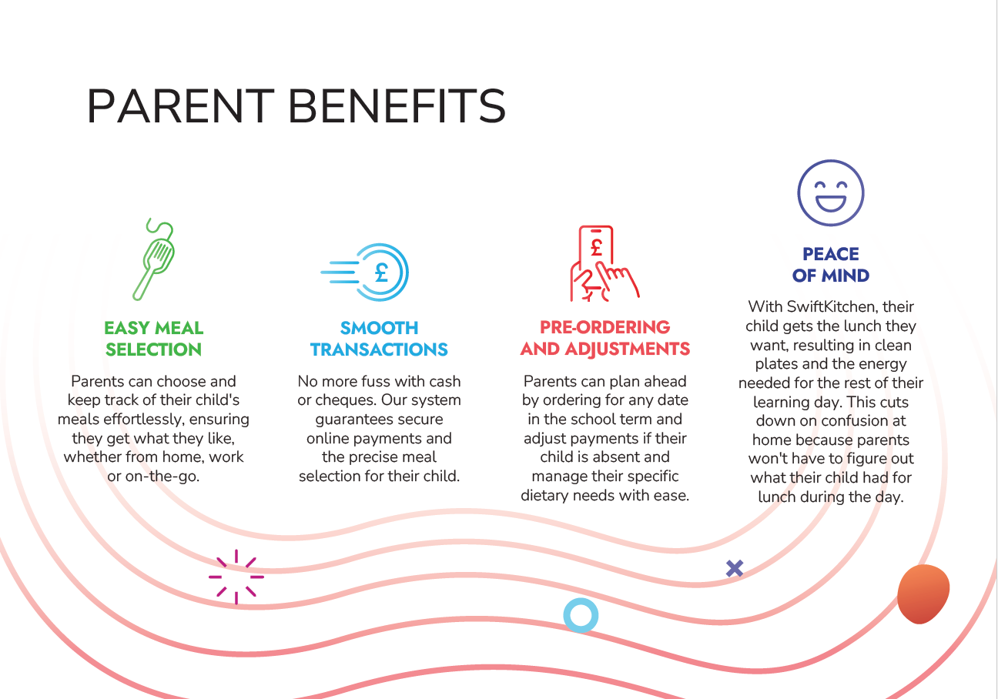
Swift Kitchen Video

Slide 9
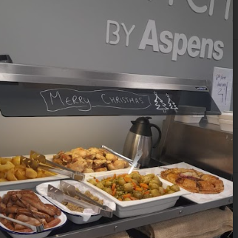
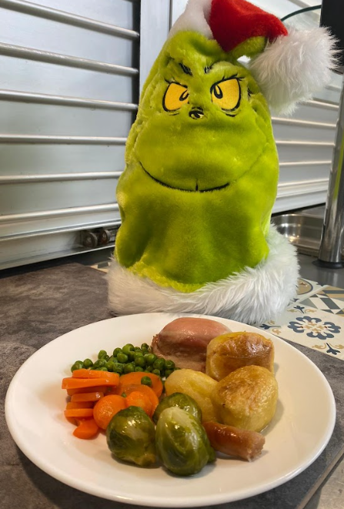
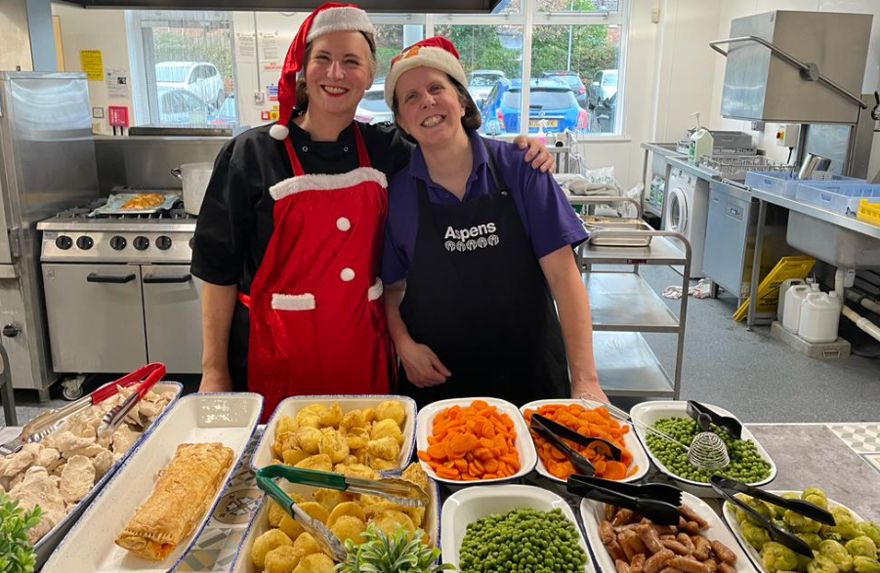
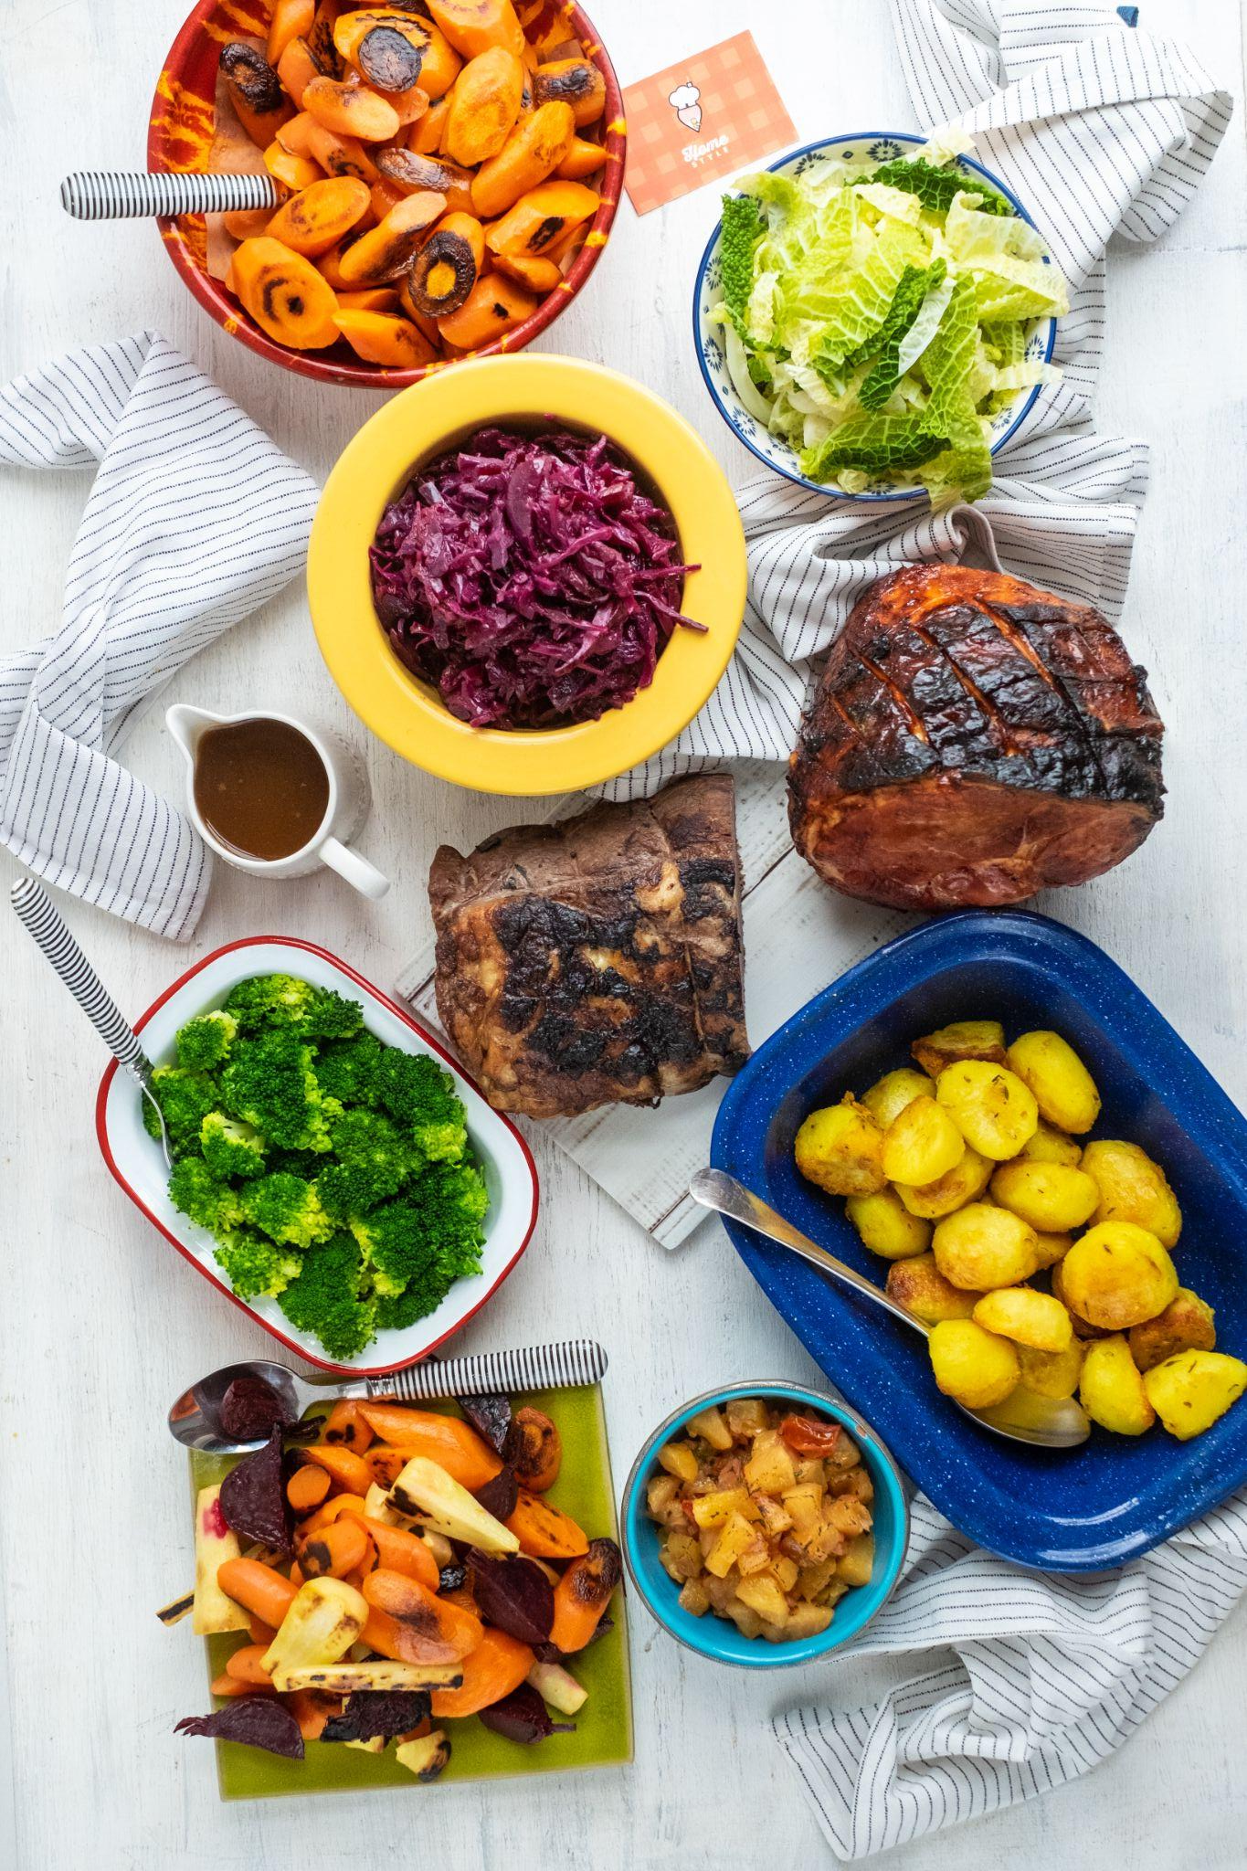
Christmas Day

Slide 10
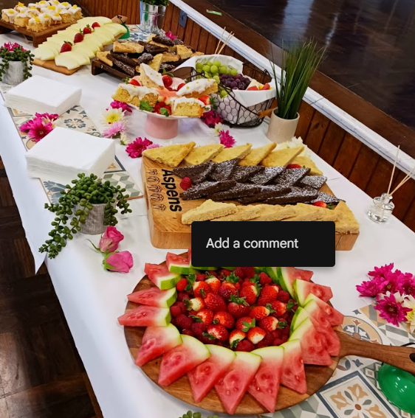
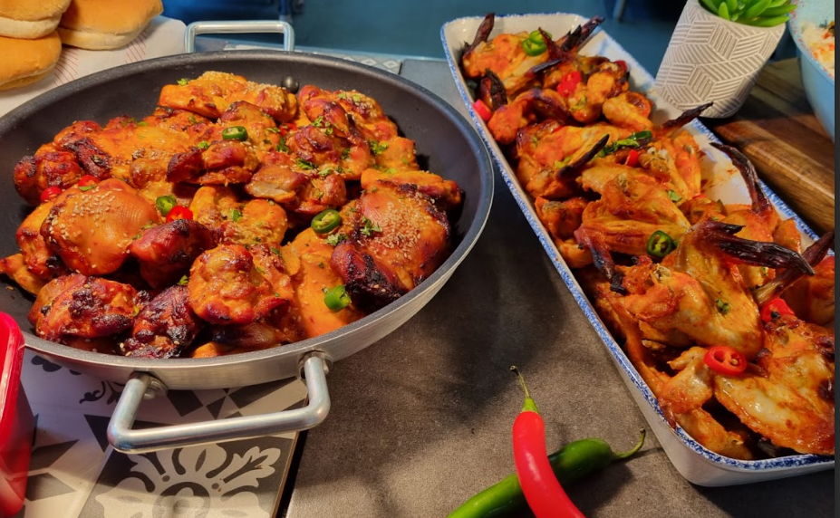
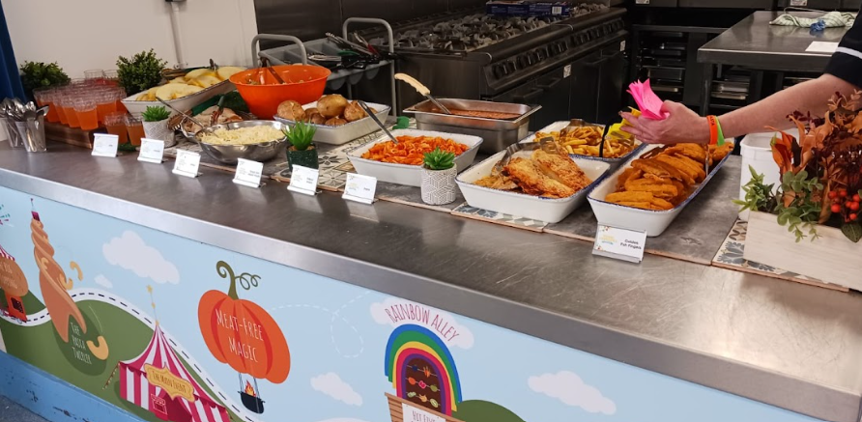
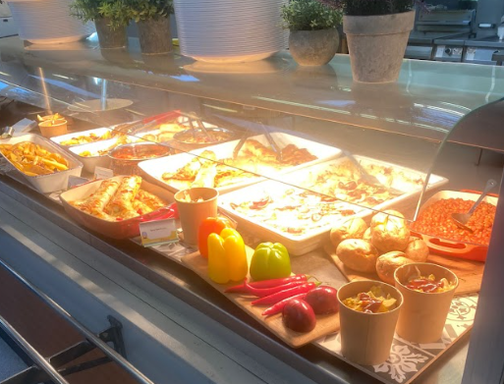
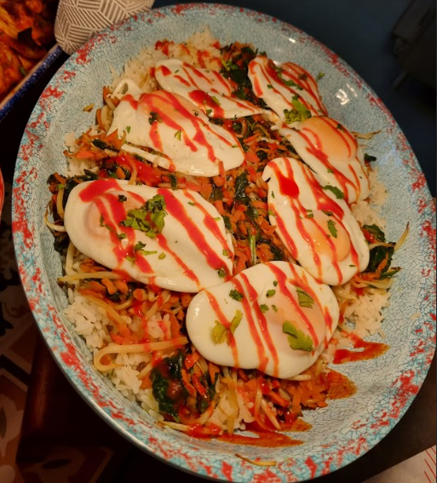
Engagement days/ Buffets

Slide 11
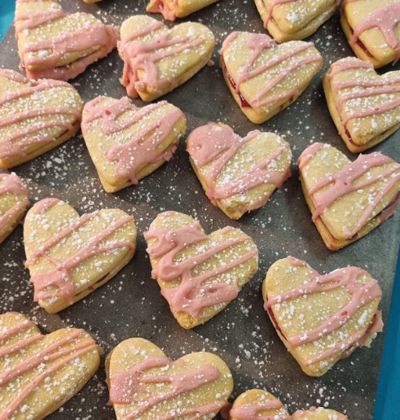
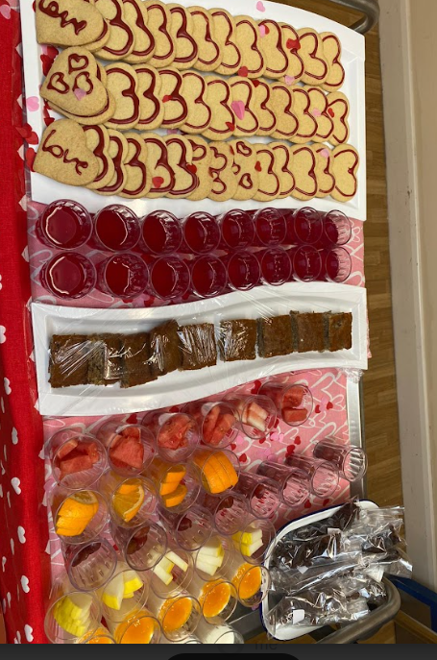
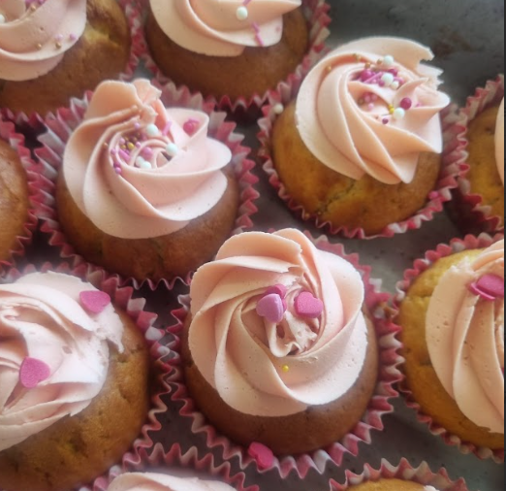
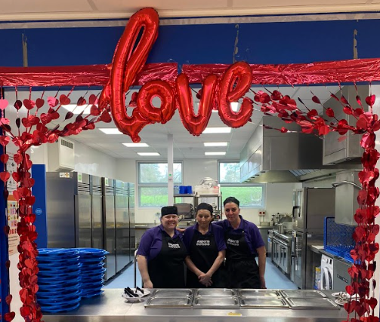
Valentines Day

Slide 13
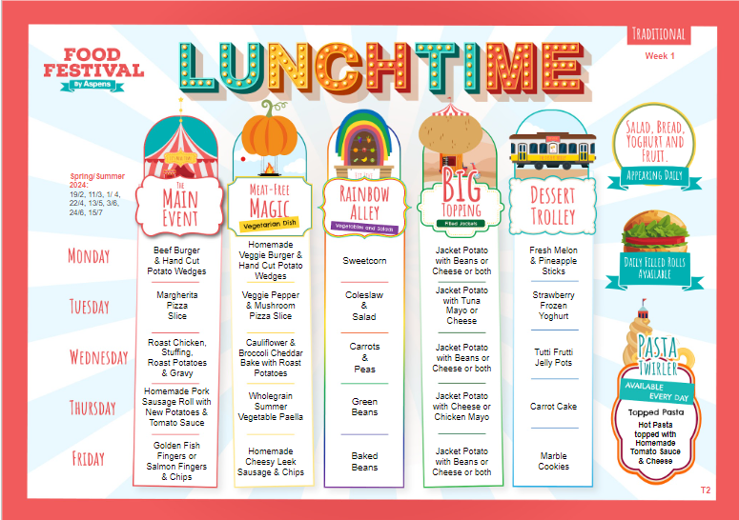
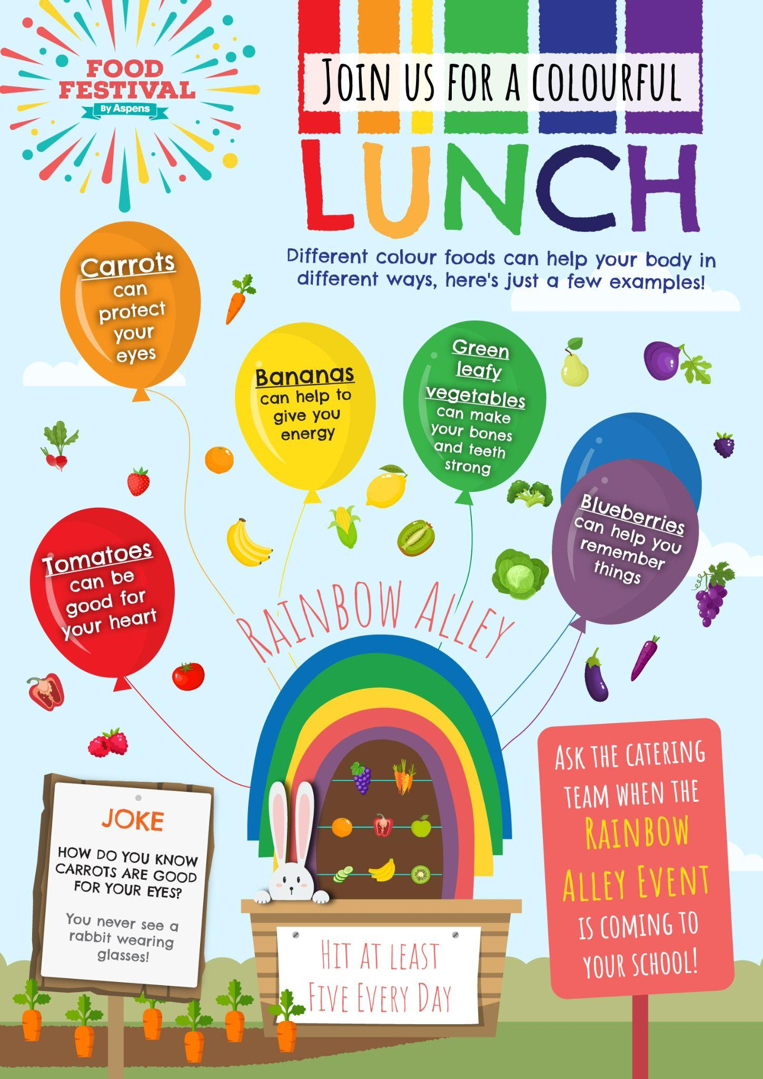
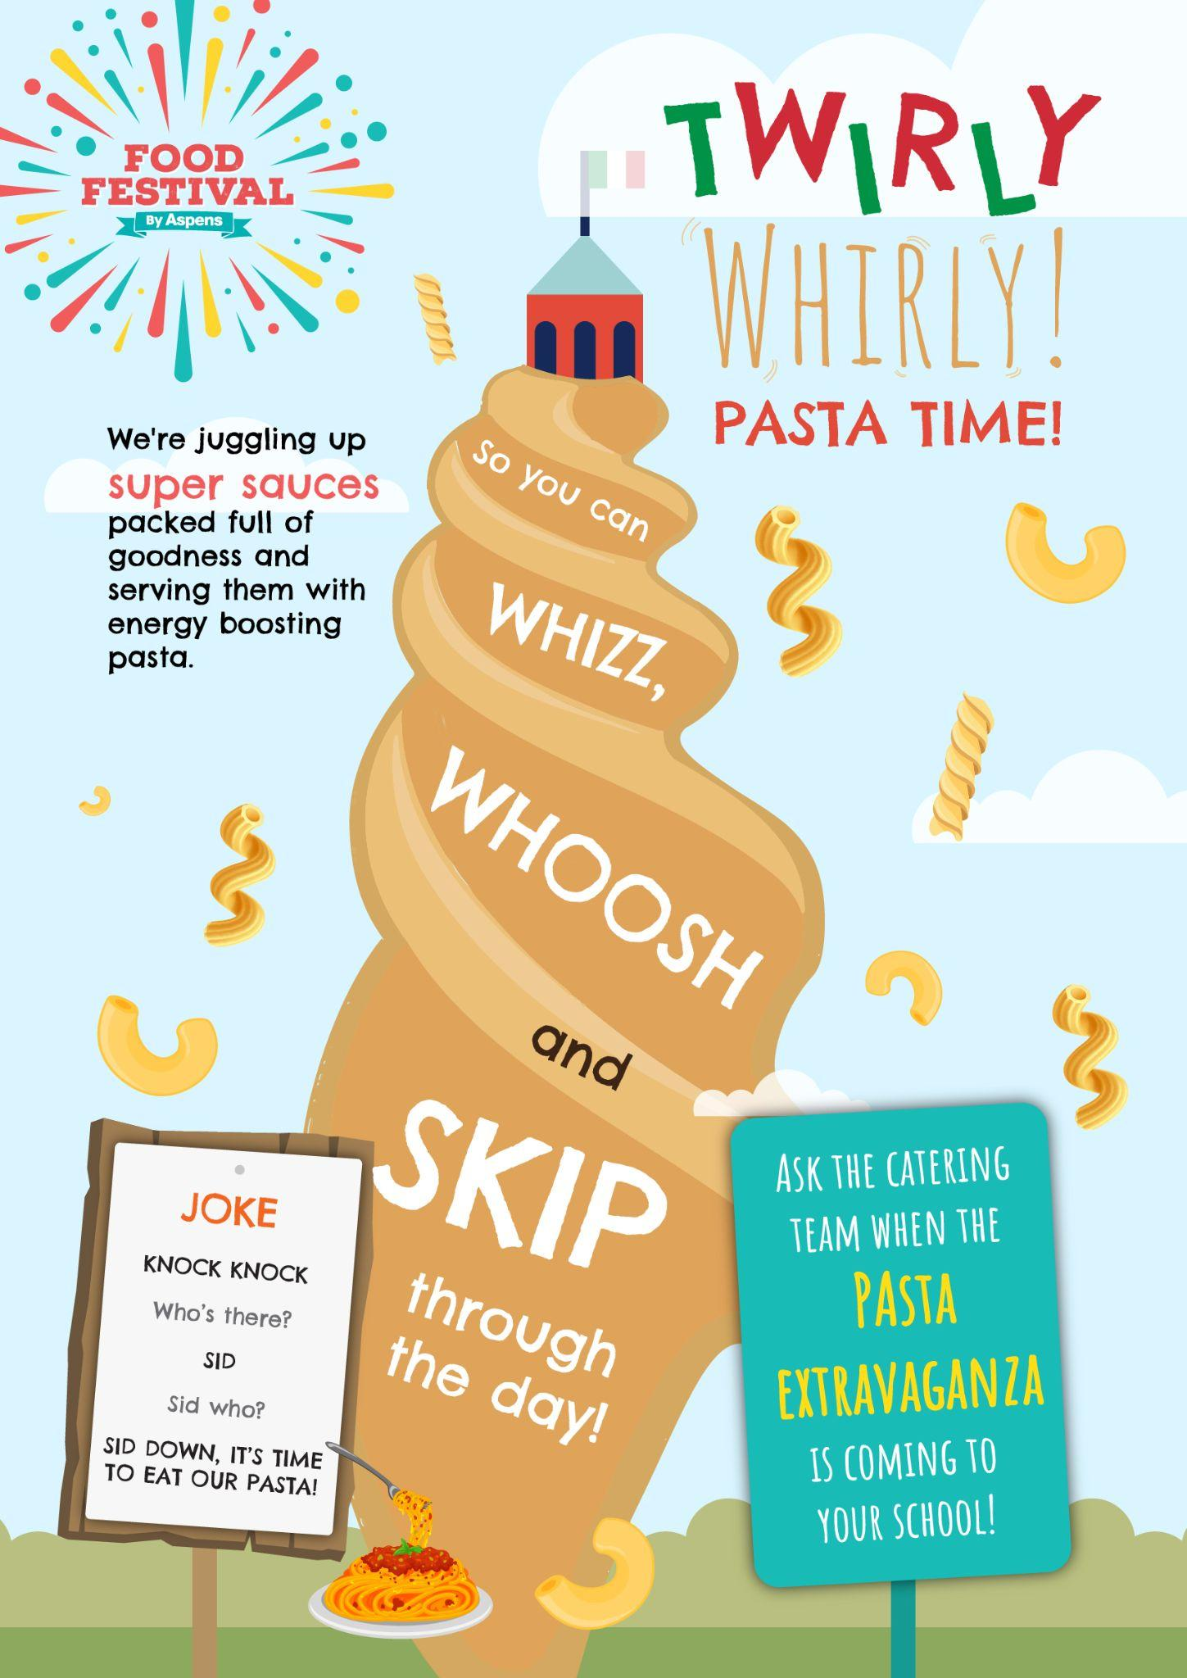
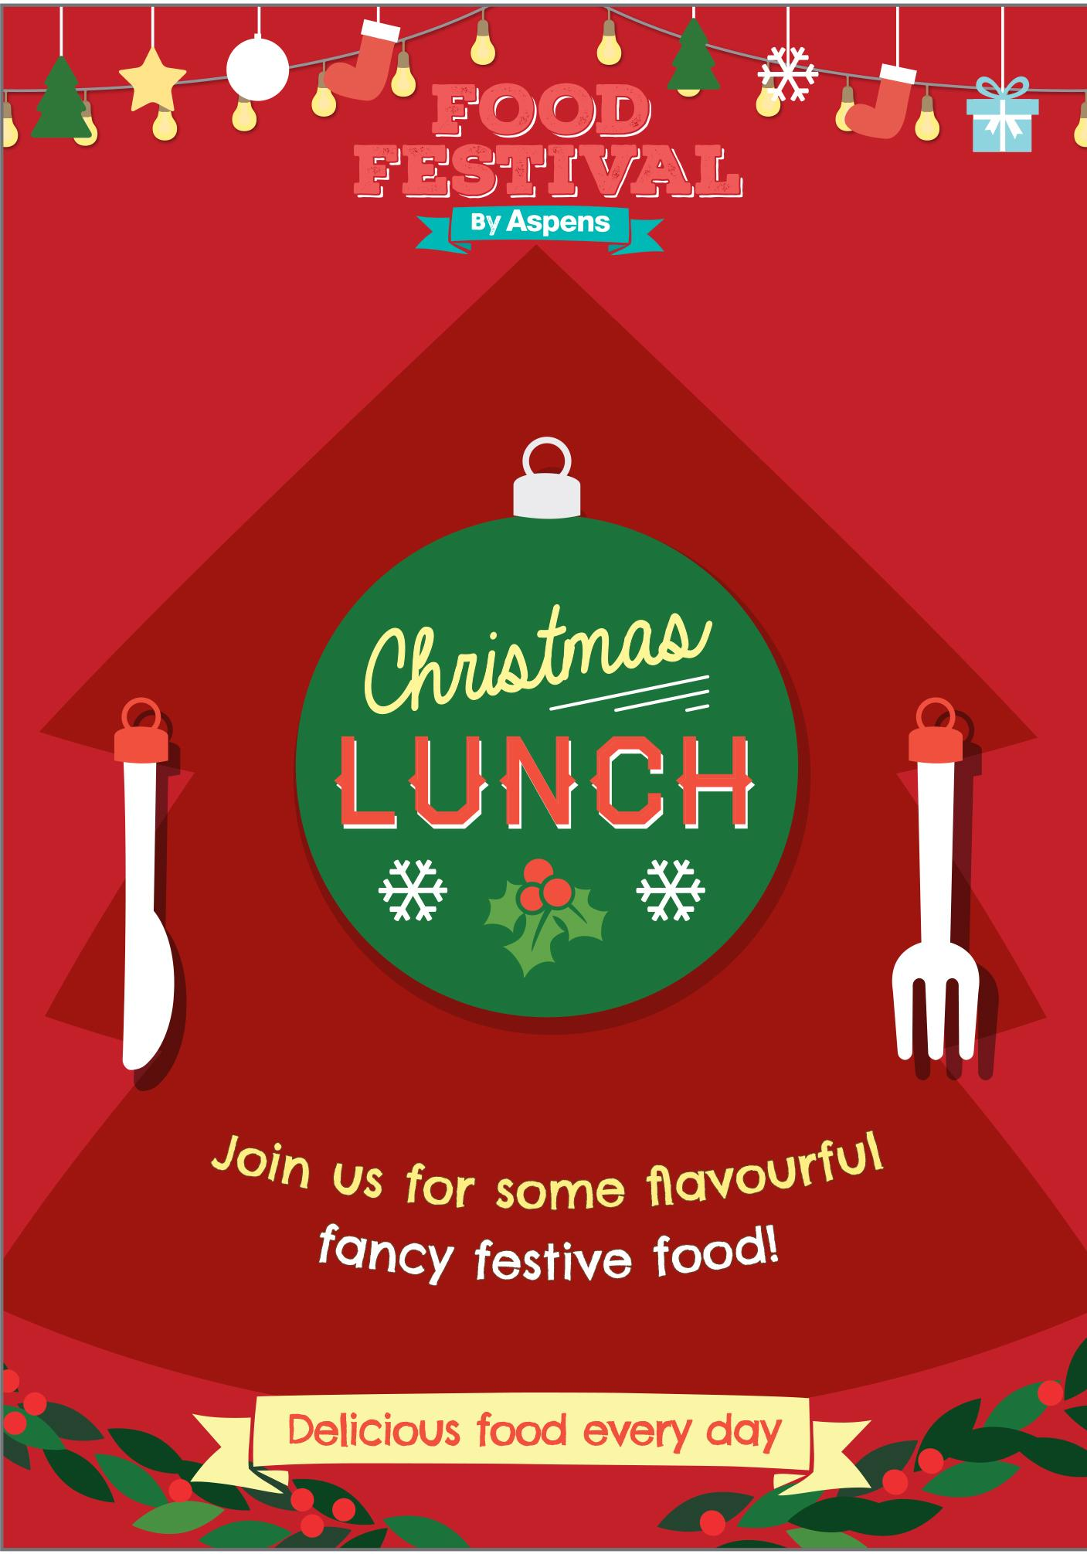
Primary Marketing Spring Summer Week 1
Autumn/ Winter Term
Event | September | October | November | December
Theme Day | Rainbow Alley | Pasta Twirler | Whizz Bang Sparkle | Christmas Lunch
Promotion | British Food Fortnight Zero Waste Week | National Curry Week (4th-9th) Halloween (31st) Census Day (Date TBC - usually 1st Thursday World Food Day (16th) Diwali (31.10 - 04.11) | World Vegan Day (1st) Bonfire Night (5th) National School Meals Week (7th-11th) Children in Need (17th) | Christmas
Pop-up Events | Seasonal - Tomato | Seasonal - Pumpkin | Seasonal - Pear | Seasonal - Parsnip
Added Value
Curriculum Links
Customer Engagement
Newsletters

Slide 14
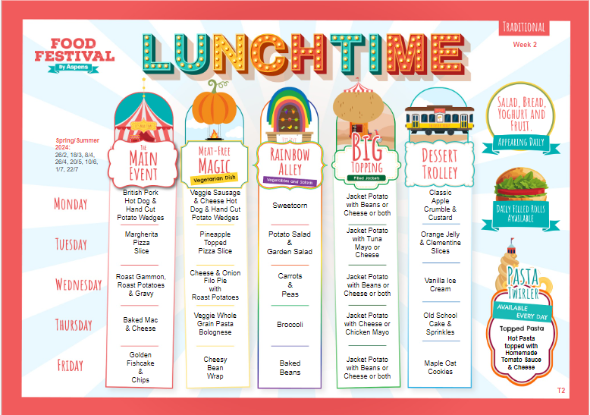
Primary Marketing Spring Summer Week 2
Autumn/ Winter Term
Event | September | October | November | December
Theme Day | Rainbow Alley | Pasta Twirler | Whizz Bang Sparkle | Christmas Lunch
Promotion | British Food Fortnight Zero Waste Week | National Curry Week (4th-9th) Halloween (31st) Census Day (Date TBC - usually 1st Thursday World Food Day (16th) Diwali (31.10 - 04.11) | World Vegan Day (1st) Bonfire Night (5th) National School Meals Week (7th-11th) Children in Need (17th) | Christmas
Pop-up Events | Seasonal - Tomato | Seasonal - Pumpkin | Seasonal - Pear | Seasonal - Parsnip
Added Value
Curriculum Links
Customer Engagement
Newsletters

Slide 15
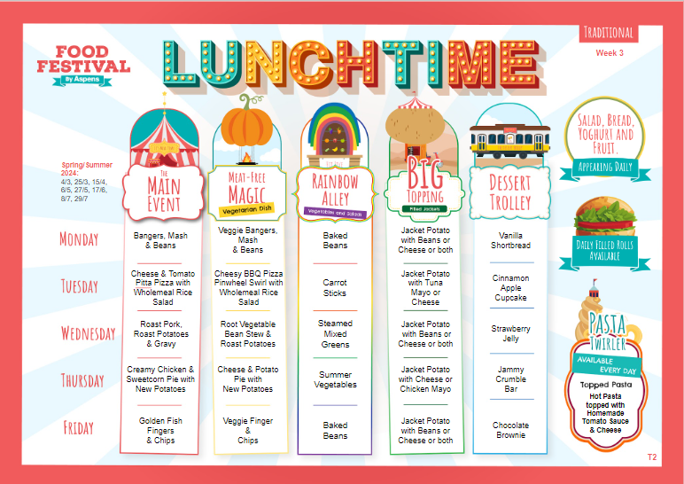
Primary Marketing Spring Summer Week 3
Autumn/ Winter Term
Event | September | October | November | December
Theme Day | Rainbow Alley | Pasta Twirler | Whizz Bang Sparkle | Christmas Lunch
Promotion | British Food Fortnight Zero Waste Week | National Curry Week (4th-9th) Halloween (31st) Census Day (Date TBC - usually 1st Thursday World Food Day (16th) Diwali (31.10 - 04.11) | World Vegan Day (1st) Bonfire Night (5th) National School Meals Week (7th-11th) Children in Need (17th) | Christmas
Pop-up Events | Seasonal - Tomato | Seasonal - Pumpkin | Seasonal - Pear | Seasonal - Parsnip
Added Value
Curriculum Links
Customer Engagement
Newsletters

Slide 16
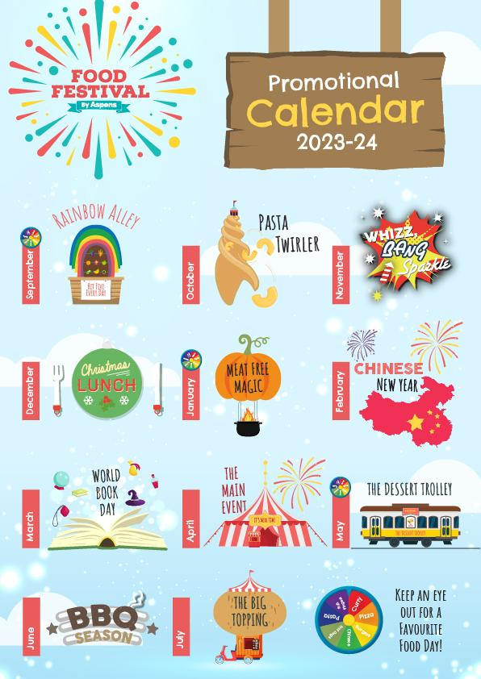
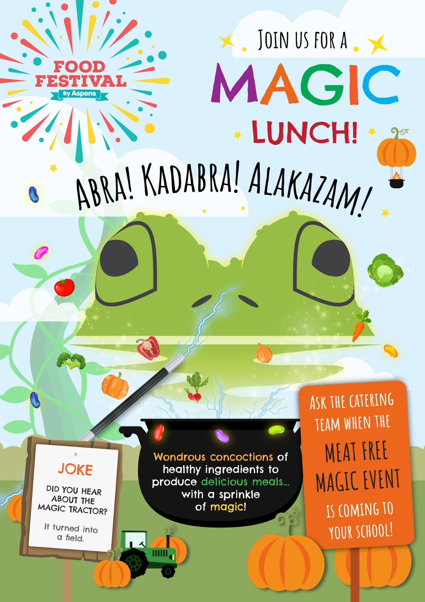
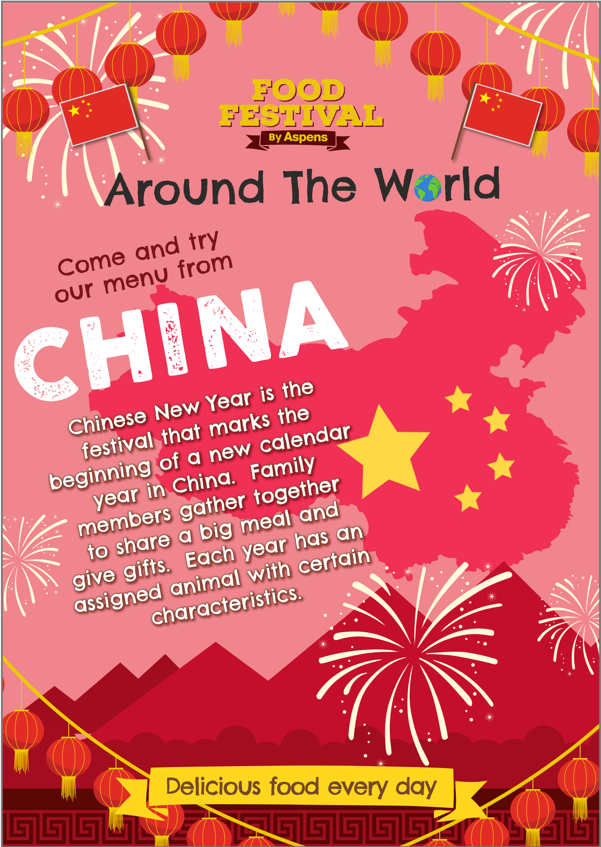
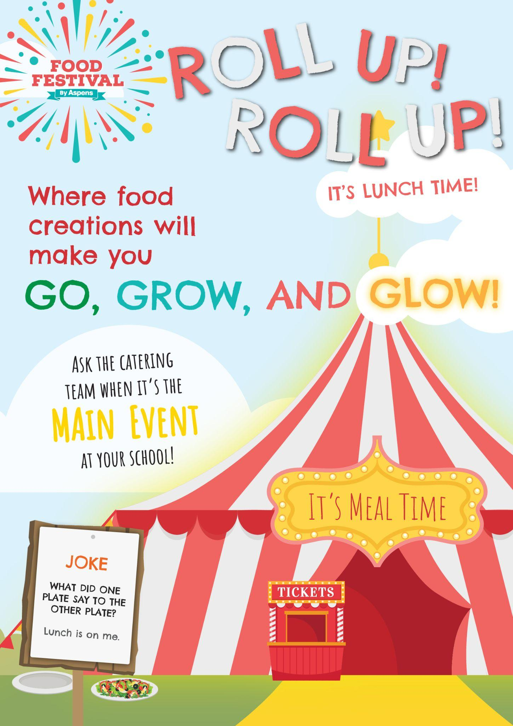
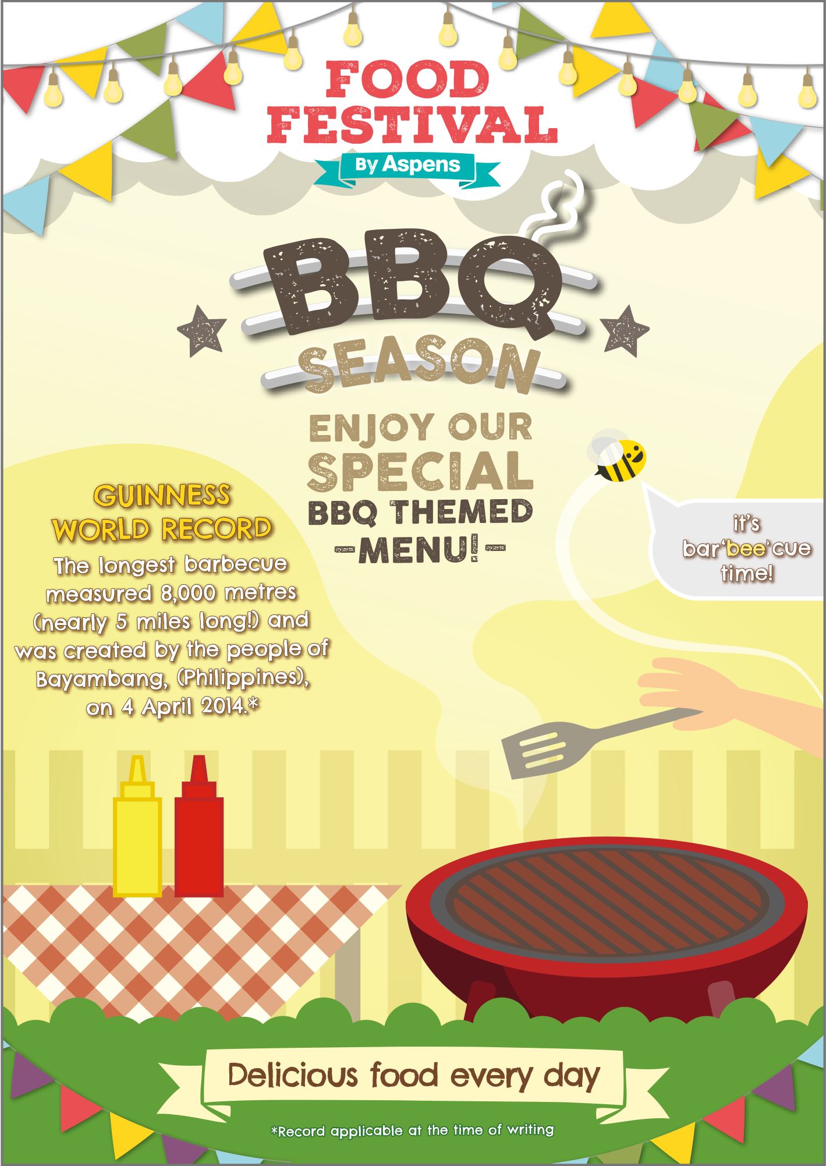
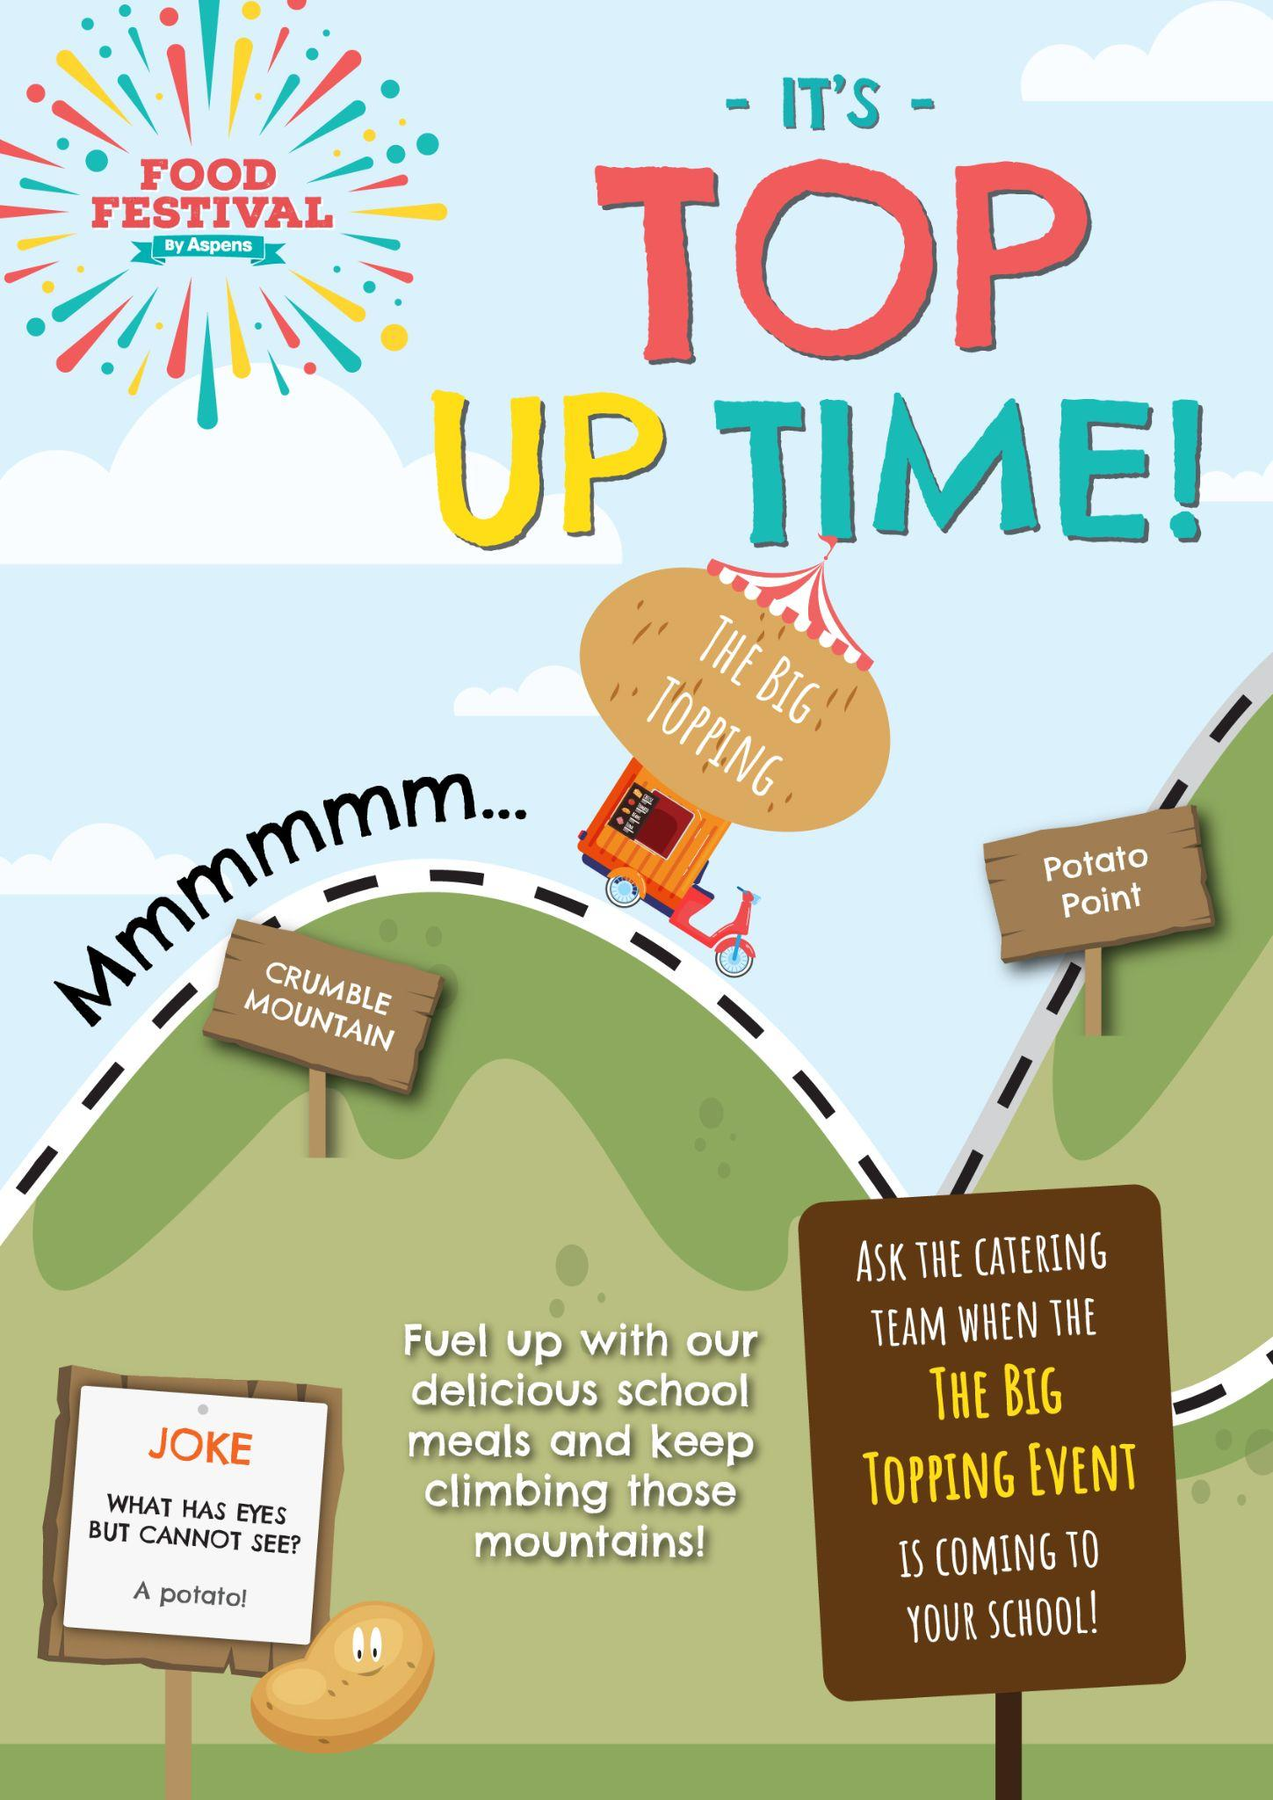
Introducing our Primary Promotional Calendar!
A mixture of the most popular promotions and introducing the new Food Festival concepts providing healthy eating messaging in a fun way!

Slide 18
Disclaimer - The information contained in these documents is confidential, privileged and only for the information of the intended recipient and may not be used, published or redistributed without the prior written consent of Aspens Services Ltd.

